Slide 1
Biostatistics III Analysis of Categorical Data
Lecture 19: Ordinal Logistic Regression Model

Slide 2
Outline
Read Hosmer and Lemeshow 8.2.

Slide 3
Introduction (I)
In Lecture 16, we introduced multinomial logistic regression model for categorical outcome variables with 3 or more levels.
Oftentimes the categorical outcome variables is ordered.
Example of ordered categorical variables
SYMPT (ME study): 1 = Strongly agree, 2 = Agree, 3 = Disagree, 4 = Strongly disagree;
DETC (ME study): 1 = Not likely, 2 = Somewhat likely, 3 = Very likely;
BWT4N (LWT study): 0 = (BWT ≤ 2500), 1 = (2500 < BWT ≤ 3000), 2 = (3000 < BWT ≤ 3500), 3 = (BWT > 3500);

Slide 4
Introduction (II)
It is OK to simply ignore the ordering and fit a multinomial logistic regression model.
However, we may also consider fitting an ordinal logistic regression model.
Advantage of an ordinal LR model:
The ORs and coefficients are easier to interpret.
Hypothesis tests are more powerful.
Disadvantage of an ordinal LR model:
Impose restrictions on the data that may be inappropriate.
The restrictions needs to be tested.

Slide 5
Three Models for Ordinal Logistic Regression
Three ways for fitting ordinal logistic regression model:
The adjacent-category model
Compare each response to the next larger response.
The continuation-ratio model
Compare each response to all lower responses.
The proportional odds model
Compare the probability of an equal or smaller response to the probability of a larger response.
Most commonly used.

Slide 6
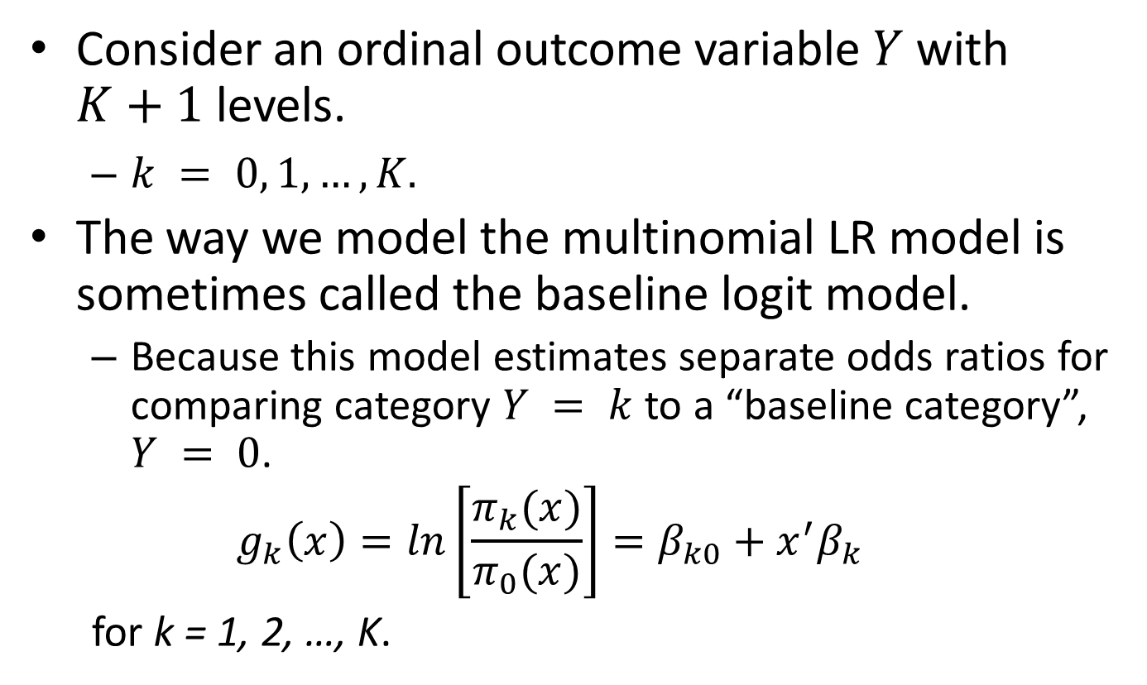
The Baseline Logit Model
Consider an ordinal outcome variable $Y$ with $K+1$ levels.
$k = 0, 1,…, K.$
The way we model the multinomial LR model is sometimes called the baseline logit model.
Because this model estimates separate odds ratios for comparing category $Y = k$ to a “baseline category”, $Y = 0$.
$$g_{k}\left(x\right)=ln\left[\frac{π_{k}(x)}{π_{0}(x)}\right]=β_{k0}+x^{′}β_{k}$$
for k = 1, 2, …, K.

Slide 7
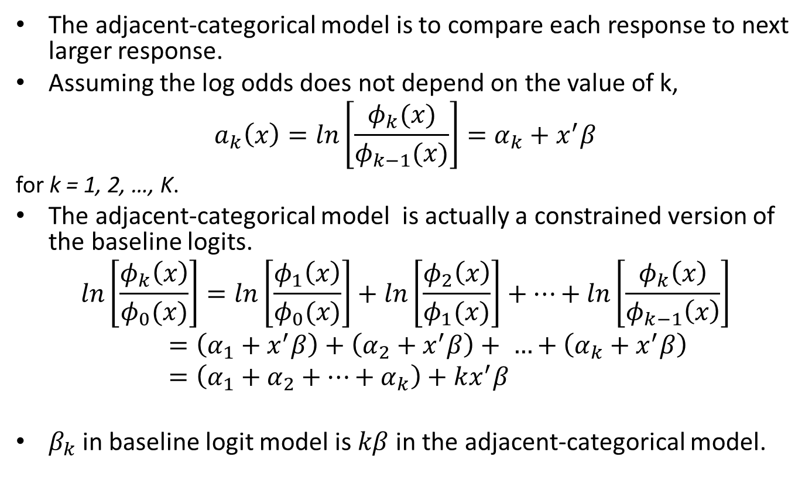
The Adjacent-Categorical Model
The adjacent-categorical model is to compare each response to next larger response.
Assuming the log odds does not depend on the value of k,
$$a_{k}\left(x\right)=ln\left[\frac{φ_{k}(x)}{φ_{k−1}(x)}\right]=α_{k}+x^{′}β$$
for k = 1, 2, …, K.
The adjacent-categorical model is actually a constrained version of the baseline logits.
$$ln\left[\frac{φ_{k}\left(x\right)}{φ_{0}(x)}\right]=ln\left[\frac{φ_{1}\left(x\right)}{φ_{0}(x)}\right]+ln\left[\frac{φ_{2}\left(x\right)}{φ_{1}(x)}\right]+…+ln\left[\frac{φ_{k}\left(x\right)}{φ_{k−1}\left(x\right)}\right]=\left(α_{1}+x^{′}β\right)+\left(α_{2}+x^{′}β\right)+ …+\left(α_{k}+x^{′}β\right)=\left(α_{1}+α_{2}+…+α_{k}\right)+kx^{′}β$$
$β_{k}$ in baseline logit model is $kβ$ in the adjacent-categorical model.

Slide 8
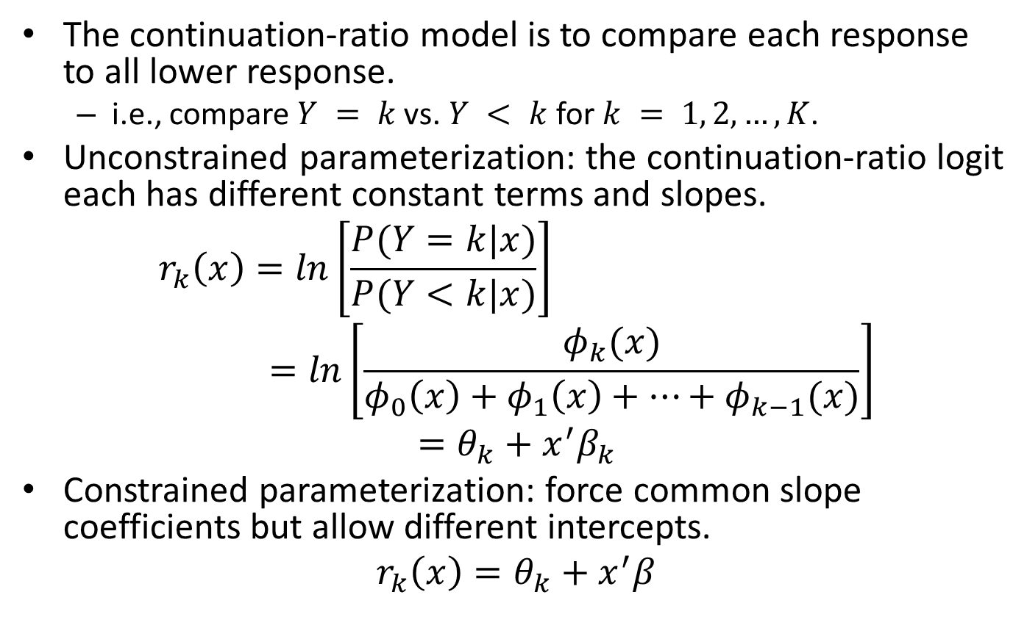
The Continuation-ratio Model
The continuation-ratio model is to compare each response to all lower response.
i.e., compare $Y = k$vs. $Y < k$for $k = 1, 2, …, K$.
Unconstrained parameterization: the continuation-ratio logit each has different constant terms and slopes.
$$r_{k}\left(x\right)=ln\left[\frac{P(Y=k|x)}{P(Y<k|x)}\right]=ln\left[\frac{φ_{k}(x)}{φ_{0}\left(x\right)+φ_{1}\left(x\right)+…+φ_{k−1}(x)}\right]$$
$$=θ_{k}+x^{′}β_{k}$$
Constrained parameterization: force common slope coefficients but allow different intercepts.
$$r_{k}\left(x\right)=θ_{k}+x^{′}β$$

Slide 9
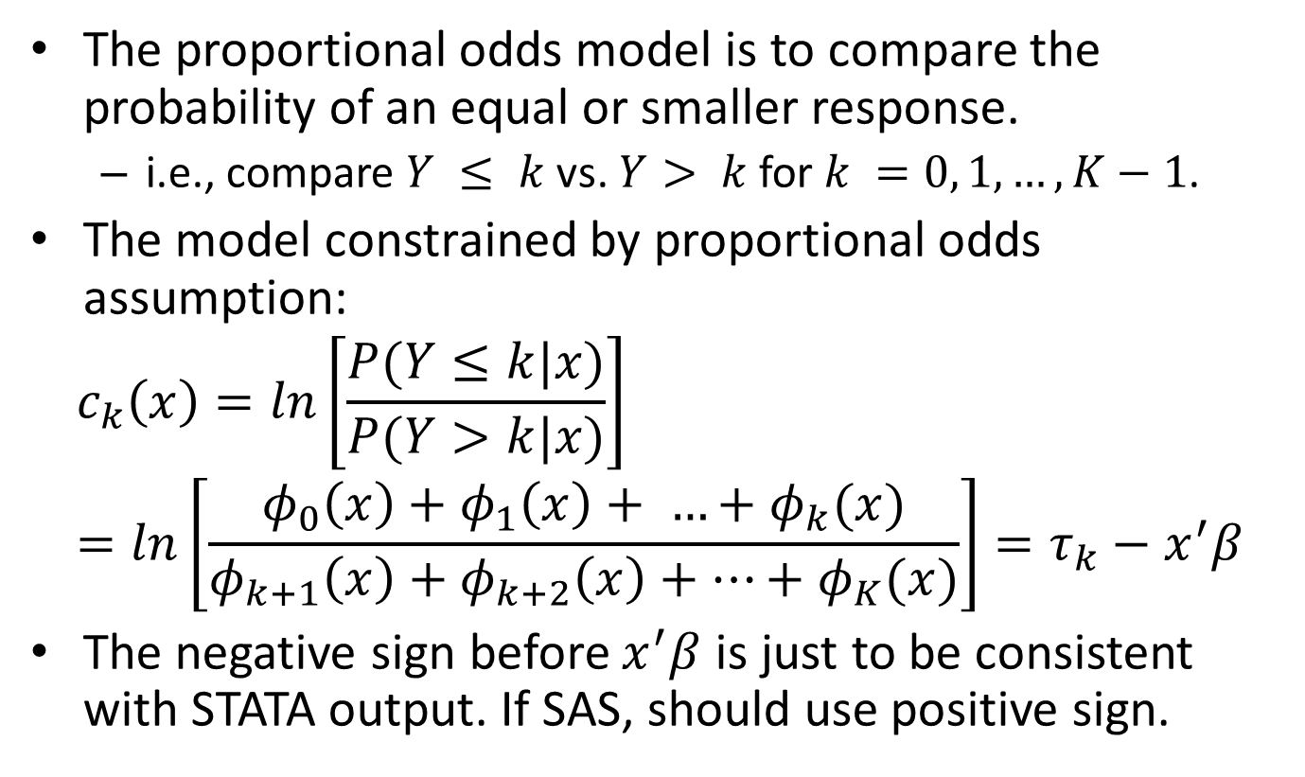
The Proportional Odds Model
The proportional odds model is to compare the probability of an equal or smaller response.
i.e., compare $Y ≤ k$vs. $Y> k$for $k =0, 1, …, K−1$.
The model constrained by proportional odds assumption:
$$c_{k}\left(x\right)=ln\left[\frac{P(Y≤k|x)}{P(Y>k|x)}\right]=ln\left[\frac{φ_{0}\left(x\right)+φ_{1}\left(x\right)+ …+φ_{k}(x)}{φ_{k+1}\left(x\right)+φ_{k+2}\left(x\right)+…+φ_{K}(x)}\right]=τ_{k}−x^{′}β$$
The negative sign before $x^{′}β$ is just to be consistent with STATA output. If SAS, should use positive sign.

Slide 10
Example: Low Birth Weight Study (I)
Remember that in the low birth weight study, BWT is recorded as a continuous variable.
Create four levels of ordered categorical outcome variable from bwt:
Bwt4 = 3 if BWT <= 2500;
Bwt4 = 2 if 2500 < BWT <= 3000;
Bwt4 = 1 if 3000 < BWT <= 3500;
Bwt4 = 0 if BWT > 3500. --- Normal birth baby as the reference group.

Slide 11
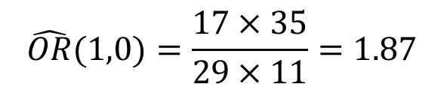
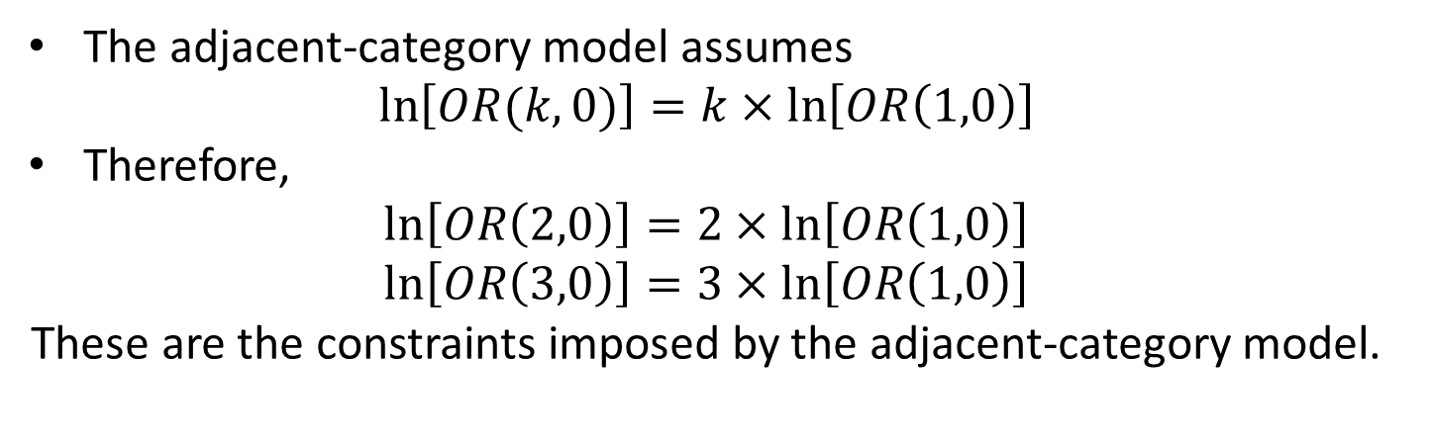
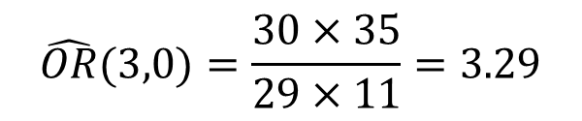
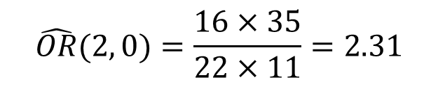
Example: Low Birth Weight Study (II)
$$\hat{OR}(1,0)=\frac{17×35}{29×11}=1.87$$
$$\hat{OR}(2, 0)=\frac{16×35}{22×11}=2.31$$
$$\hat{OR}(3,0)=\frac{30×35}{29×11}=3.29$$
The adjacent-category model assumes
$$\ln\left[OR(k,0)\right]=k×\ln\left[OR\left(1,0\right)\right]$$
Therefore,
$$\ln\left[OR\left(2,0\right)\right]=2×\ln\left[OR\left(1,0\right)\right]$$
$$\ln\left[OR\left(3,0\right)\right]=3×\ln\left[OR\left(1,0\right)\right]$$
These are the constraints imposed by the adjacent-category model.

Slide 12
STATA Code for Adjacent-category Model
. mlogit bwt4 smoke, baseoutcome(0) rrr
. constraint define 1 [2]smoke=2*[1]smoke.
. constraint define 2 [3]smoke=3*[1]smoke
. mlogit bwt4 smoke, constraint(1 2) baseoutcome(0)
0.74 = 2 * 0.37
1.11 = 3 * 0.37

Slide 13
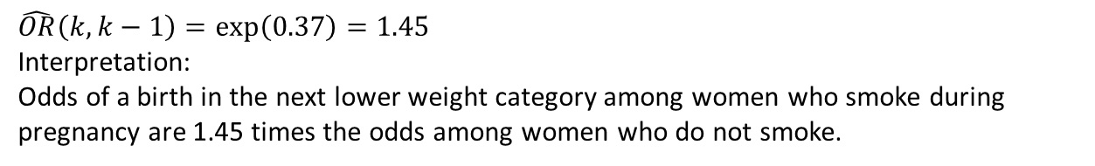
Compute Logits for Adjacent-Category Model
$$\hat{OR}\left(k, k−1\right)=\exp\left(0.37\right)=1.45$$
Interpretation:
Odds of a birth in the next lower weight category among women who smoke during pregnancy are 1.45 times the odds among women who do not smoke.
$${\hat{a}}_{1}\left(SMOKE\right)=−.11+.37×SMOKE$$
$${\hat{a}}_{2}\left(SMOKE\right)=−.441+0.739×SMOKE−\left(\left(−0.11\right)−0.37×SMOKE\right)=−0.331+0.370×SMOKE$$
$${\hat{a}}_{3}\left(SMOKE\right)=−0.175+1.11×SMOKE−\left(\left(−0.441\right)−0.739×SMOKE\right)=0.266+0.370×SMOKE$$

Slide 14

SAS Code for Adjacent-category Model
data bwt;
set catclass.lowbwt;
if bwt >3500 then bcat = 0;
else if 3000 < bwt <= 3500 then bcat = 1;
else if 2500 < bwt <= 3000 then bcat = 2;
else bcat = 3;
run;
proc catmod data = bwt;
population smoke;
response alogits;
model bcat =
(0 1 0 0,
0 0 1 0,
0 0 0 1,
1 1 0 0,
1 0 1 0,
1 0 0 1) /ML ;
run;
Analysis of Weighted Least Squares Estimates
Effect | Parameter | Estimate | Standard Error | Chi- Square | Pr > ChiSq
Model | 1 | 0.3684 | 0.1346 | 7.49 | 0.0062
 | 2 | -0.1088 | 0.2104 | 0.27 | 0.6051
 | 3 | -0.3333 | 0.2254 | 2.19 | 0.1391
 | 4 | 0.2670 | 0.2205 | 1.47 | 0.2259
smoke
$${\hat{β}}_{smoke}$$
Intercept from each logit

Slide 15
STATA Code for Continuation-ratio Model (I)
Unconstrained continuation-ratio model.
$r_{k}\left(x\right)=θ_{k}+x^{′}β_{k}$
. logit bwt4 smoke if bwt4 == 0 | bwt4 == 1
. gen bwc2 = .
. replace bwc2 = 0 if bwt4 == 0 | bwt4 == 1
. replace bwc2 = 1 if bwt4 == 2
. logit bwc2 smoke
. gen bwc3 = 0.
. replace bwc3 = 1 if bwt4 == 3
. logit bwc3 smoke

Slide 16
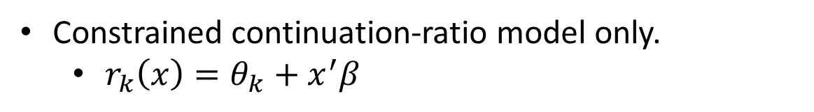
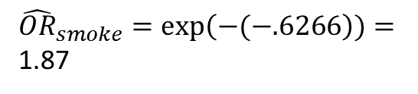
STATA Code for Continuation-ratio Model (II)
Constrained continuation-ratio model only.
$r_{k}\left(x\right)=θ_{k}+x^{′}β$
Negative sign here is to adjust for the reversed order of response from adjacent-category approach to make it comparable to the OR computed in adjacent-category approach.
. findit ocratio
. gen bwt4_rec = bwt4
. recode bwt4_rec 0 = 3 1 = 2 2 = 1 3 = 0
${\hat{OR}}_{smoke}=\exp\left(−(−.6266\right))=$ 1.87

Slide 17
STATA Code for Continuation-ratio Model
proc logistic data = bwt;
where bcat = 0 | bcat = 1;
model bcat (event="1") = smoke;
run;
data bwt2;
set bwt;
if (bcat = 0 | bcat = 1) then bcat2 = 0;
else if bcat = 2 then bcat2 = 1;
run;
proc logistic data = bwt2;
model bcat2 (event="1") = smoke;
run;
data bwt3;
set bwt;
if (bcat = 3) then bcat3 = 1;
else bcat3 = 0;
run;
proc logistic data = bwt3;
model bcat3 (event="1") = smoke;
run;

Slide 18
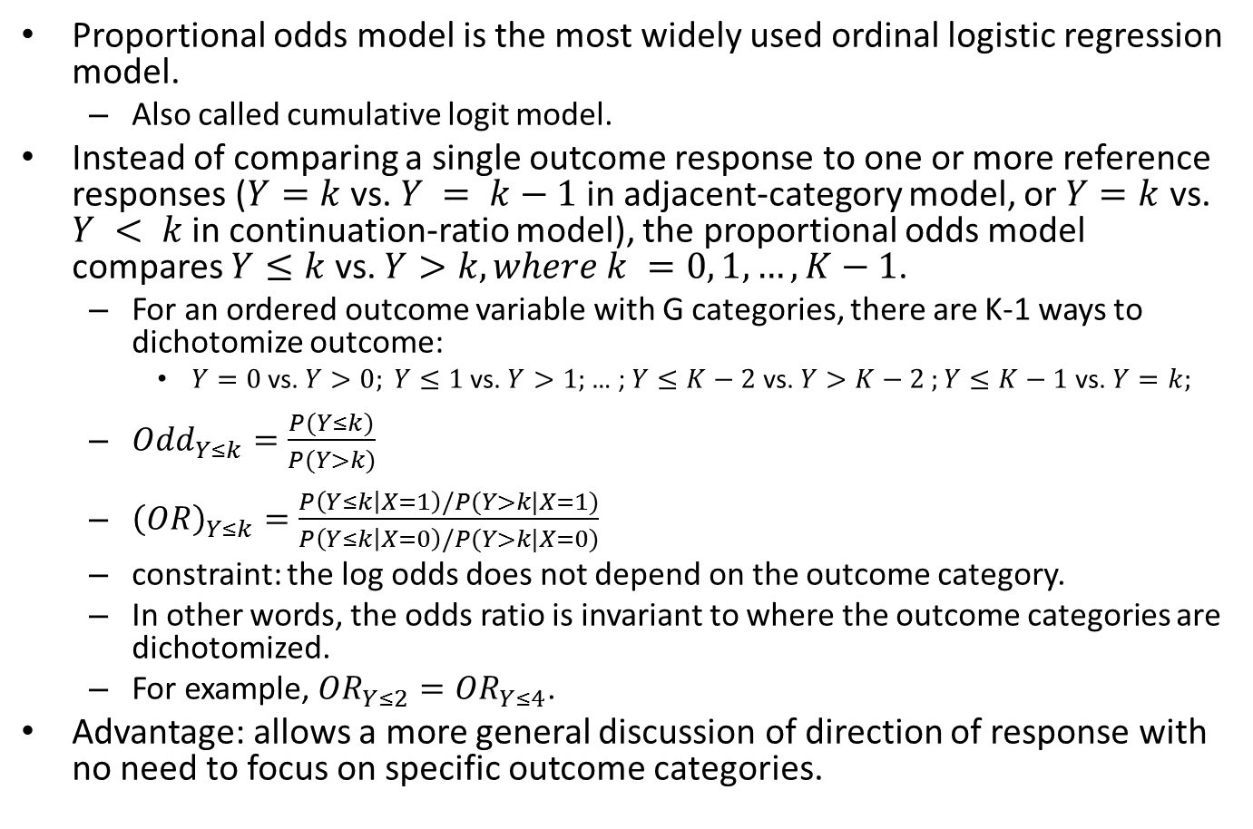
Proportional Odds Model --- Some More Points
Proportional odds model is the most widely used ordinal logistic regression model.
Also called cumulative logit model.
Instead of comparing a single outcome response to one or more reference responses ($Y=k$ vs. $Y = k−1$in adjacent-category model, or $Y=k$ vs. $Y < k$in continuation-ratio model), the proportional odds model compares $Y≤k$ vs. $Y>k,where k =0, 1, …, K−1$.
For an ordered outcome variable with G categories, there are K-1 ways to dichotomize outcome:
$Y=0$ vs. $Y>0; Y≤1$ vs. $Y>1;$… ; $Y≤K−2$ vs. $Y>K−2 ;Y≤K−1$ vs. $Y=k;$
$O{dd}_{Y≤k}=\frac{P(Y≤k)}{P(Y>k)}$
${\left(OR\right)}_{Y≤k}=\frac{P\left(Y≤k | X=1\right)/P(Y>k|X=1)}{P\left(Y≤k | X=0\right)/P(Y>k|X=0)}$
constraint: the log odds does not depend on the outcome category.
In other words, the odds ratio is invariant to where the outcome categories are dichotomized.
For example, $OR_{Y≤2}=OR_{Y≤4}$.
Advantage: allows a more general discussion of direction of response with no need to focus on specific outcome categories.

Slide 19


STATA Code for Proportional Odds Model
It is more convenient to code the ordinal outcome so that it increases with the underling continuous response.
Same as bwt4_rec created for continuation-ratio model.
gen bwt4n = 0.
. replace bwt4n = 1 if 2500 < bwt & bwt <=3000
. replace bwt4n = 2 if 3000 < bwt & bwt <=3500
. replace bwt4n = 3 if bwt > 3500
. ologit bwt4n lwt
$$c_{k}\left(x\right)=τ_{k}−x^{′}β$$
The ‘or’ option in STATA does not consider the negative sign of the logit.
. ologit bwt4n lwt, or
$$\exp\left({\hat{β}}_{lwt}\right)=1.0128$$

Slide 20
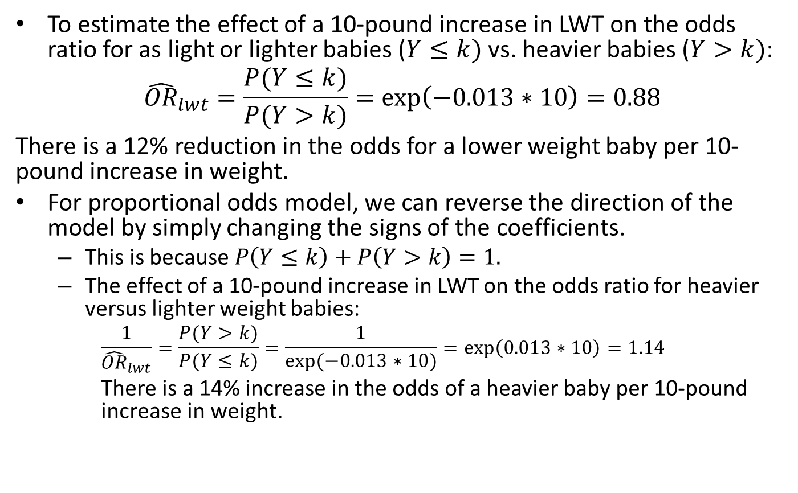
Odds Ratio for Proportional Odds Model (I)
To estimate the effect of a 10-pound increase in LWT on the odds ratio for as light or lighter babies ($Y≤k)$ vs. heavier babies ($Y>k)$:
$${\hat{OR}}_{lwt}=\frac{P(Y≤k)}{P(Y>k)}=exp\left(−0.013∗10\right)=0.88$$
There is a 12% reduction in the odds for a lower weight baby per 10-pound increase in weight.
For proportional odds model, we can reverse the direction of the model by simply changing the signs of the coefficients.
This is because $P\left(Y≤k\right)+P\left(Y>k\right)=1.$
The effect of a 10-pound increase in LWT on the odds ratio for heavier versus lighter weight babies:
$$\frac{1}{{\hat{OR}}_{lwt}}=\frac{P(Y>k)}{P(Y≤k)}=\frac{1}{exp⁡(−0.013∗10)}=exp\left(0.013∗10\right)=1.14$$
There is a 14% increase in the odds of a heavier baby per 10-pound increase in weight.

Slide 21

Odds Ratio for Proportional Odds Model (II)
Similarly, to estimate the odds ratio for smoke,
. ologit bwt4n smoke
$${\hat{OR}}_{smoke}=\frac{P(Y≤k)}{P(Y>k)}=exp\left(−(−0.7608)\right)=2.14$$
Interpretation: women who smoke during pregnancy have 2.1 times the odds of a lower versus a heavier baby than women who do not smoke.
$$\frac{1}{{\hat{OR}}_{lwt}}=\frac{P(Y>k)}{P(Y≤k)}=exp\left(−0.7608\right)=0.47$$
Interpretation: the odds of a heavier versus lighter weight baby are 53% less for women who smoke during pregnancy.

Slide 22
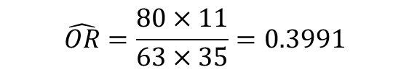
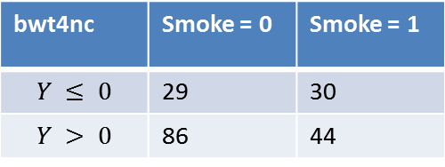
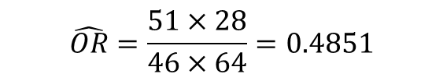
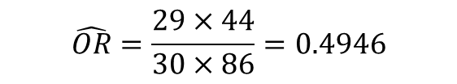
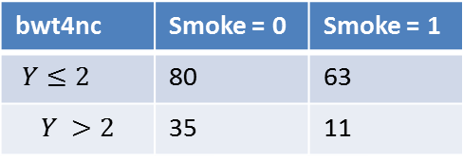
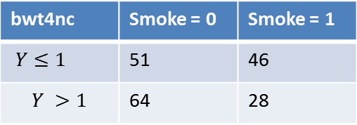
Checking Proportional Odds Assumption (I)
Model assumption: proportional odds
This is to say that the odds ratio does not depends on k.
bwt4nc | Smoke = 0 | Smoke = 1
$$Y ≤ 0$$ | 29 | 30
$$Y > 0$$ | 86 | 44
$$\hat{OR}=\frac{29×44}{30×86}=0.4946$$
bwt4nc | Smoke = 0 | Smoke = 1
$Y≤1$ | 51 | 46
$$Y >1$$ | 64 | 28
bwt4nc | Smoke = 0 | Smoke = 1
$Y≤2$ | 80 | 63
$$Y >2$$ | 35 | 11
Same OR?
$$\hat{OR}=\frac{51×28}{46×64}=0.4851$$
$$\hat{OR}=\frac{80×11}{63×35}=0.3991$$

Slide 23
Checking Proportional Odds Assumption (II)
A more formal check for proportional odds assumption can be:
Compare the fitted proportional odds model to the unconstrained baseline logit model via either a score or likelihood ratio test.
. findit omodel
. omodel logit bwt4n lwt
Call it “approximate” because we cannot enforce proportional odds assumption by placing linear constraints on the coefficients in the baseline model.

Slide 24
SAS Code for Proportional Odds Model (I)
proc logistic data = bwt descending;
model bcat = lwt ;
run;
Analysis of Maximum Likelihood Estimates
Parameter |  | DF | Estimate | Standard Error | Wald Chi-Square | Pr > ChiSq
Intercept | 3 | 1 | 0.8320 | 0.5857 | 2.0181 | 0.1554
Intercept | 2 | 1 | 1.7073 | 0.5937 | 8.2707 | 0.0040
Intercept | 1 | 1 | 2.8315 | 0.6176 | 21.0210 | <.0001
lwt |  | 1 | -0.0127 | 0.00445 | 8.2081 | 0.0042
Suggests the proportional odds assumption satisfied.
Odds Ratio Estimates
Effect | Point Estimate | 95% Wald Confidence Limits
lwt | 0.987 | 0.979 | 0.996
Score Test for the Proportional Odds Assumption
Chi-Square | DF | Pr > ChiSq
0.8794 | 2 | 0.6442

Slide 25
SAS Code for Proportional Odds Model (II)
proc logistic data = bwt descending;
class smoke;
model bcat = smoke ;
run;
Score Test for the Proportional Odds Assumption
Chi-Square | DF | Pr > ChiSq
0.3602 | 2 | 0.8352
Analysis of Maximum Likelihood Estimates
Parameter |  | DF | Estimate | Standard Error | Wald Chi-Square | Pr > ChiSq
Intercept | 3 | 1 | -0.7359 | 0.1601 | 21.1267 | <.0001
Intercept | 2 | 1 | 0.1327 | 0.1508 | 0.7746 | 0.3788
Intercept | 1 | 1 | 1.2471 | 0.1771 | 49.5974 | <.0001
smoke | 0 | 1 | -0.3804 | 0.1364 | 7.7800 | 0.0053
Odds Ratio Estimates
Effect | Point Estimate | 95% Wald Confidence Limits
smoke 0 vs 1 | 0.467 | 0.274 | 0.798

Slide 26
Model Building Strategies for Ordinal LR Models
We should follow the same model building strategies for the binary LR model.
Stepwise selection for main effect.
Check for the scale of continuous covariates
using design-variable approach.
Fit K separate binary regressions and check for nonlinearity using fractional polynomial analyses.
Check the omitted covariates one by one to ensure they are not significant risk factors or confounders of main effects in the model.
Check for interactions.
Check for assumptions (e.g., proportional odds assumption for proportional odds model).

Slide 27
Diagnostic Statistics and Goodness-of-fit Tests for Ordinal LR Model
Fit separate binary LR models, conduct diagnostic statistics to each model for identifying influential and poorly fit subjects.
Because the diagnostic statistics is not checking the actual fitted model, all results should be checked by deleting identified subjects and refitting the ordinal model.

Slide 28
The Low Birth Weight Data
Limiting to those that are included in the final model.
Variable | Description | Codes/Values
bwt4n | Categorized baby weight | 0 : BWT ≤ 2500 1: 2500 < BWT ≤ 3000 2: 3000 < BWT ≤ 3500 3: BWT > 3500
age | Age of Mother | years
lwt | Weight of mother at last menstrual period | pounds
race | Race | 1 = White 2 = Black 3 = Other
smoke | Smoking status during pregnancy | 0 = No 1 = Yes
ptd | Dichotomized history of premature labor | 0 = No 1 = Yes
ht | History of hypertension | 0 = No 1 = Yes
ui | Presence of Uterine Irritability | 0 = No 1 = Yes

Slide 29
Final Proportional Odds Model
. xi: ologit bwt4n age lwt i.race smoke ht ui ptd
Age is included because of its known clinical importance.

Slide 30
Final Proportional Odds Model
proc logistic data = bwt descending;
class race(ref="1") /coding=reference;
model bcat = age lwt race smoke ht ui ptd ;
run;
Analysis of Maximum Likelihood Estimates
Parameter |  | DF | Estimate | Standard Error | Wald Chi-Square | Pr > ChiSq
Intercept | 3 | 1 | -0.4956 | 0.9004 | 0.3030 | 0.5820
Intercept | 2 | 1 | 0.5158 | 0.8995 | 0.3288 | 0.5664
Intercept | 1 | 1 | 1.8031 | 0.9099 | 3.9273 | 0.0475
age |  | 1 | -0.00063 | 0.0274 | 0.0005 | 0.9818
lwt |  | 1 | -0.0129 | 0.00501 | 6.6337 | 0.0100
race | 2 | 1 | 1.4708 | 0.4476 | 10.7985 | 0.0010
race | 3 | 1 | 0.8693 | 0.3344 | 6.7597 | 0.0093
smoke |  | 1 | 0.9877 | 0.3135 | 9.9244 | 0.0016
ht |  | 1 | 1.1937 | 0.5916 | 4.0708 | 0.0436
ui |  | 1 | 0.9130 | 0.4077 | 5.0134 | 0.0252
ptd |  | 1 | 0.8221 | 0.4075 | 4.0687 | 0.0437
Note the different sign of SAS from STATA output

Slide 31
Final Proportional Odds Model
Odds Ratio Estimates
Effect | Point Estimate | 95% Wald Confidence Limits
age | 0.999 | 0.947 | 1.055
lwt | 0.987 | 0.978 | 0.997
race 2 vs 1 | 4.353 | 1.810 | 10.464
race 3 vs 1 | 2.385 | 1.239 | 4.594
smoke | 2.685 | 1.452 | 4.964
ht | 3.299 | 1.035 | 10.520
ui | 2.492 | 1.121 | 5.541
ptd | 2.275 | 1.024 | 5.057
Score Test for the Proportional Odds Assumption
Chi-Square | DF | Pr > ChiSq
23.0891 | 16 | 0.1114
After controlling for the age and weight of the mother, race other than white, smoking during pregnancy, history of hypertension, uterine irritability and history of a preterm delivery increase the odds of a lighter versus heavier birth.
The increase in the odds is 4.4 times for black versus white race, and is 2.3 times for patients with history of pre-term delivery versus those without history of pre-term delivery.

